Slide 1


INVESTOR PRESENTATION
M&E GENIUS PRO
Intelligent Monitoring & Evaluation for Better Project Decisions
Célio Matusse
Built by
Founder & CEO
KPH Services, Lda.
01

Slide 2
THE PROBLEM
Projects Generate Data.
Decisions Still Lag Behind.
1
2
3
Fragmented information
Slow analysis & reporting
Delayed decisions
Project teams generate large amounts of monitoring data, often spread across different processes and tools.
Turning raw monitoring data into structured reports and insight can be time-consuming and manual.
Decision-makers need timely, understandable information — but it doesn't always arrive when it's needed.
Decision-makers in the development sector need timely, understandable information to act with confidence.
M&E GENIUS PRO · KPH Services, Lda.
02

Slide 3
THE M&E GAP
Too Much Manual Work.
Too Little Actionable Intelligence.
DATA
→
MONITORING
→
ANALYSIS
→
REPORTING
→
DECISION
Manual, fragmented handoffs between each stage slow the path from raw data to a confident decision.
“ Too much manual work. Too little actionable intelligence. ”
03

Slide 4
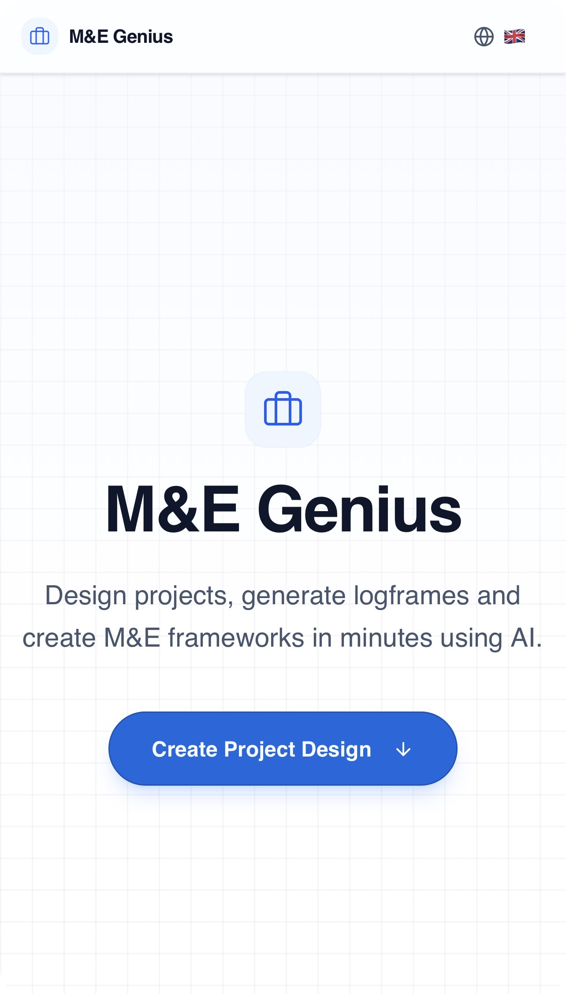
THE SOLUTION
Meet M&E Genius Pro
A digital solution designed to help organisations transform monitoring and evaluation information into more structured, accessible and actionable management intelligence.
From monitoring data to better decisions.
REAL PRODUCT INTERFACE
Design projects, generate logframes and create M&E frameworks in minutes — the product shown on this page is the actual M&E Genius Pro application.
M&E GENIUS PRO · KPH Services, Lda.
04

Slide 5
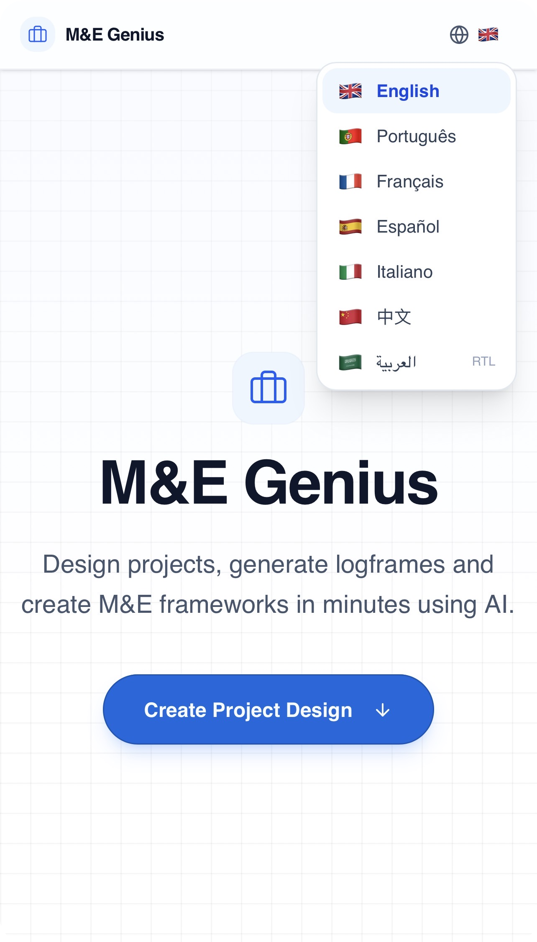
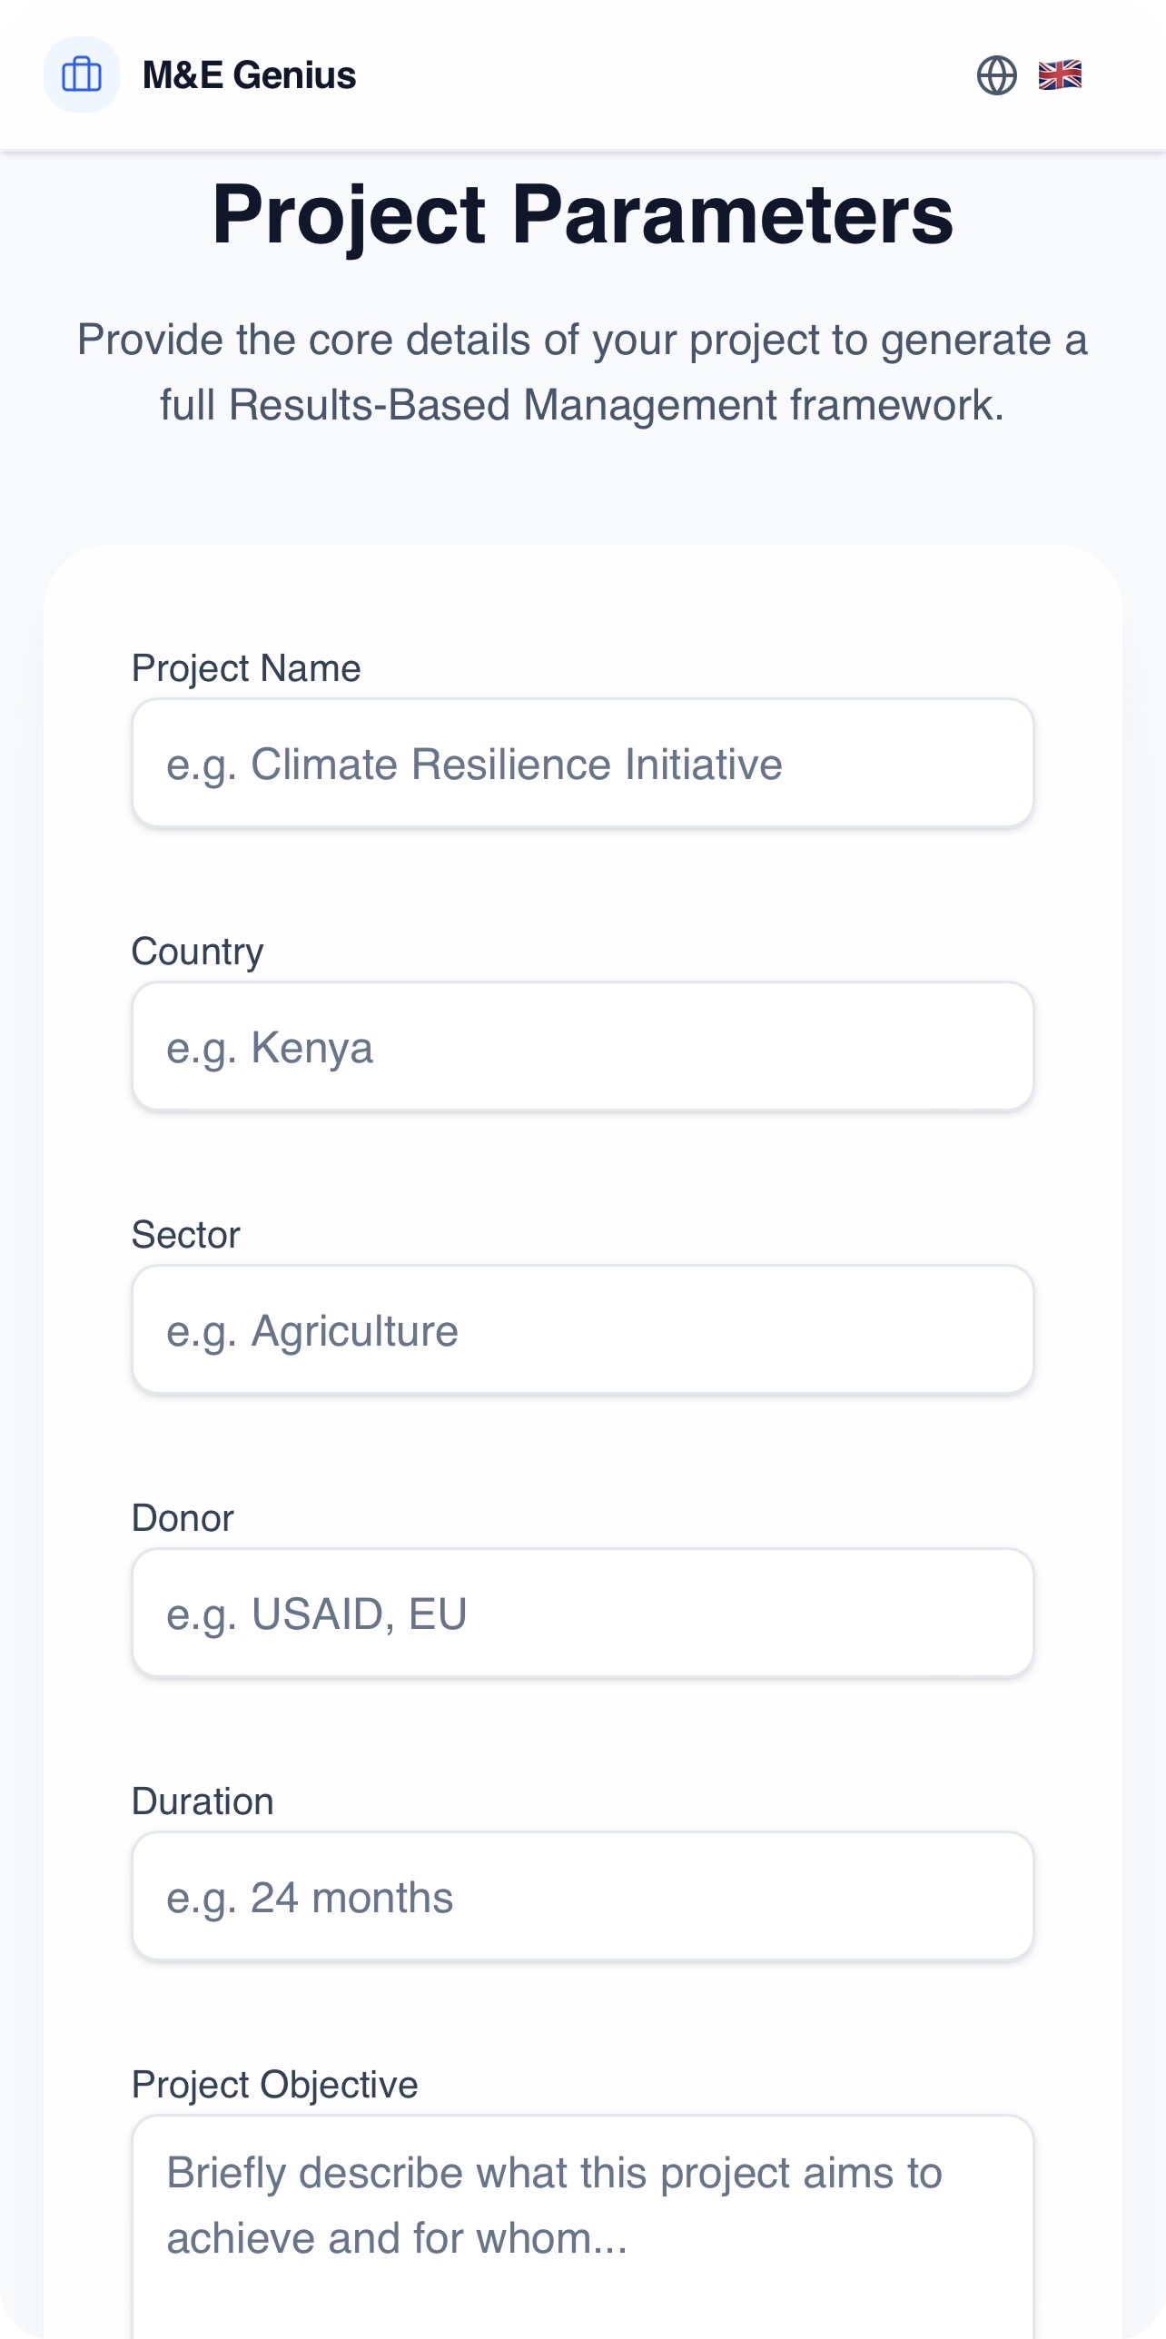
THE REAL PRODUCT
REAL SCREENSHOTS — UNEDITED
This Is M&E Genius Pro
The screens below are authentic captures of the live application — not mockups. They show the actual project-setup and language experience available to users today.
Landing & value proposition
Multi-language interface
Project parameters intake
M&E GENIUS PRO · KPH Services, Lda.
05

Slide 6
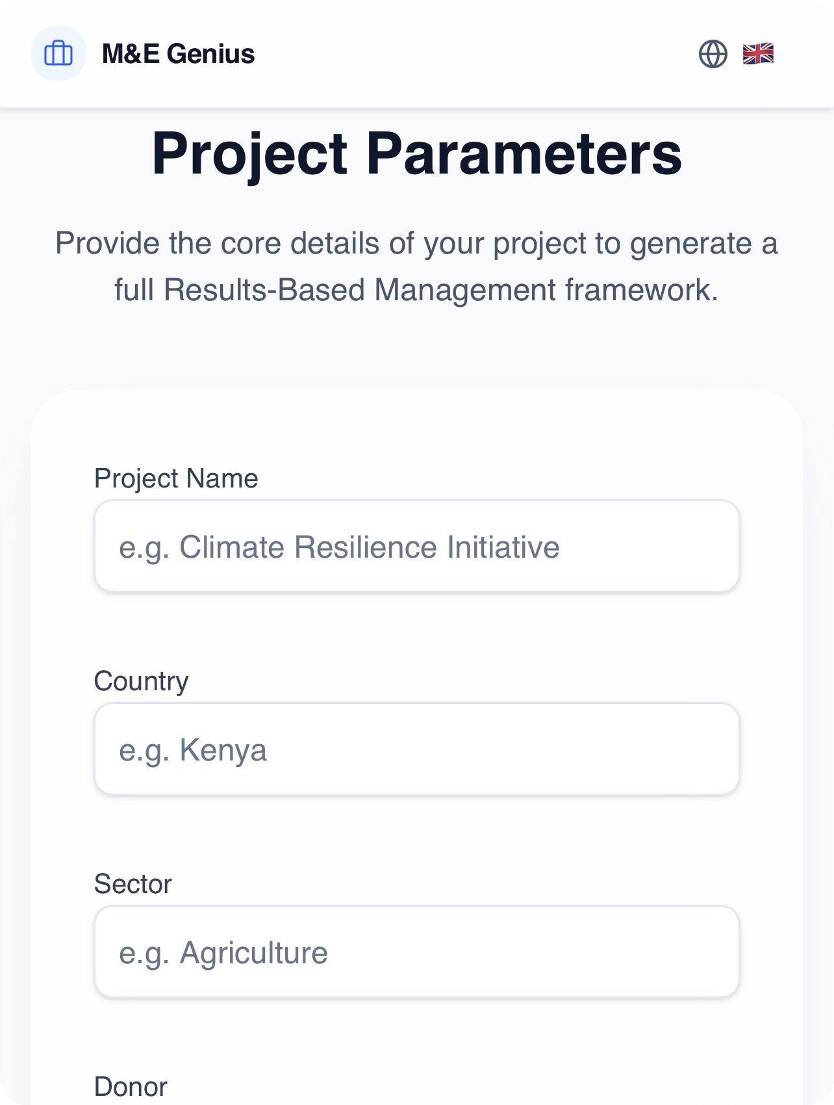
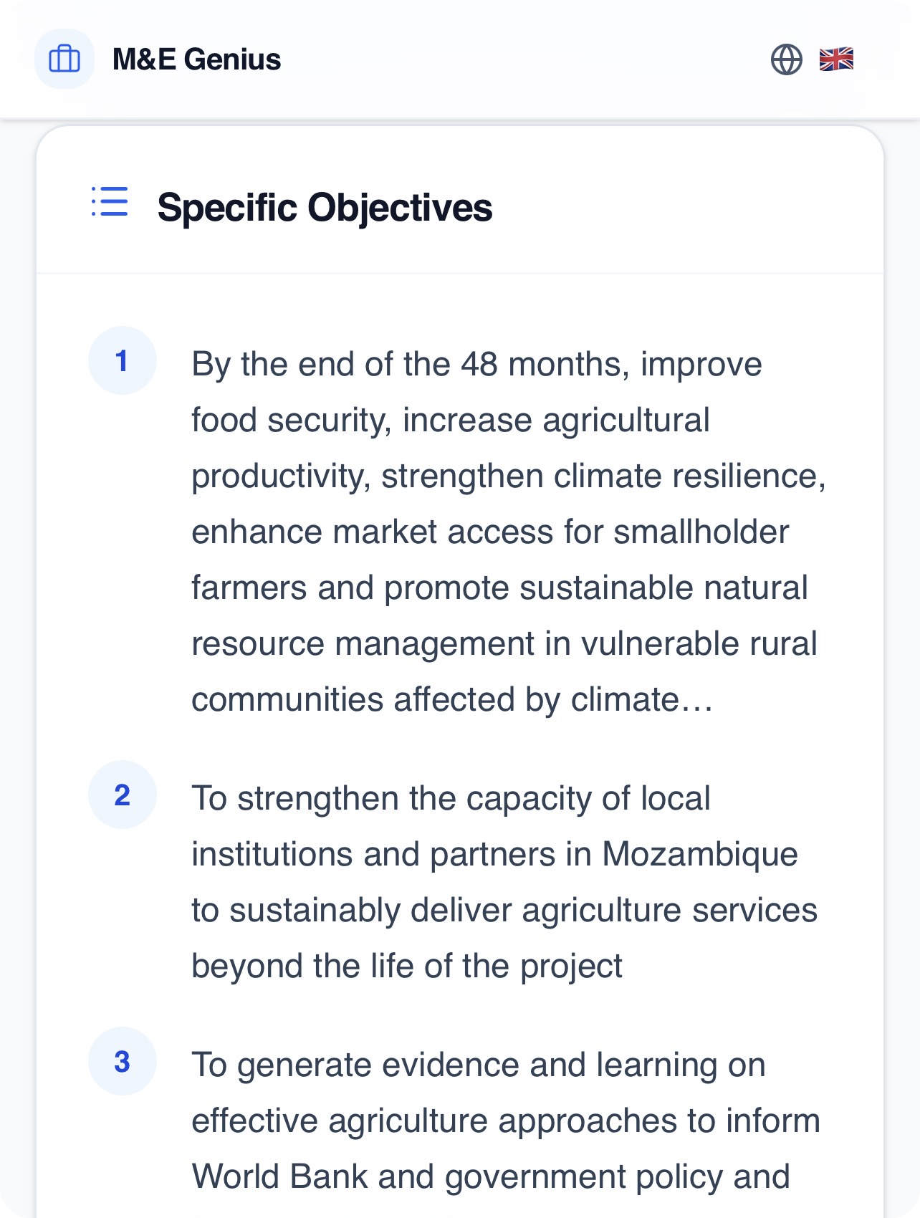
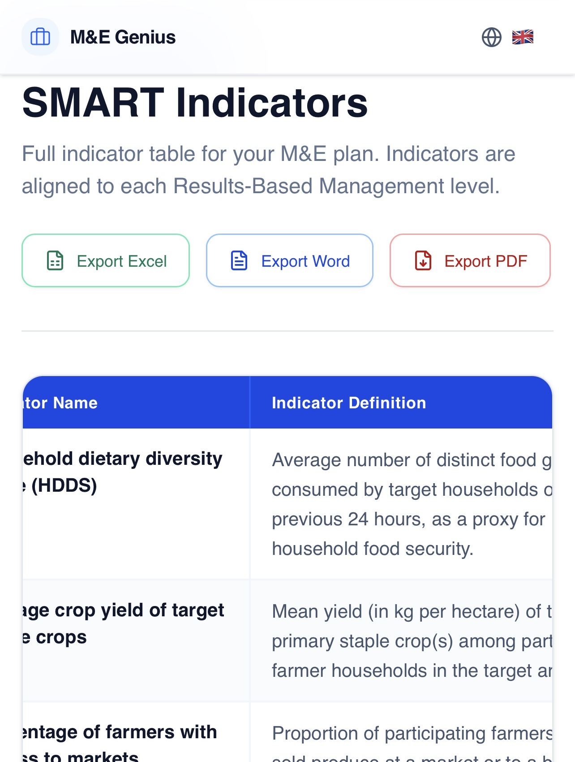
HOW THE PRODUCT WORKS
ILLUSTRATIVE DEMO PROJECT
From Project Information to Decision Support
INPUT
PROCESS
OUTPUT
Project / M&E information
Monitoring, organisation & analysis
Insights, indicators & reporting
→
→
Only workflow steps demonstrated by the product screenshots are shown — no module names are invented.
06

Slide 7
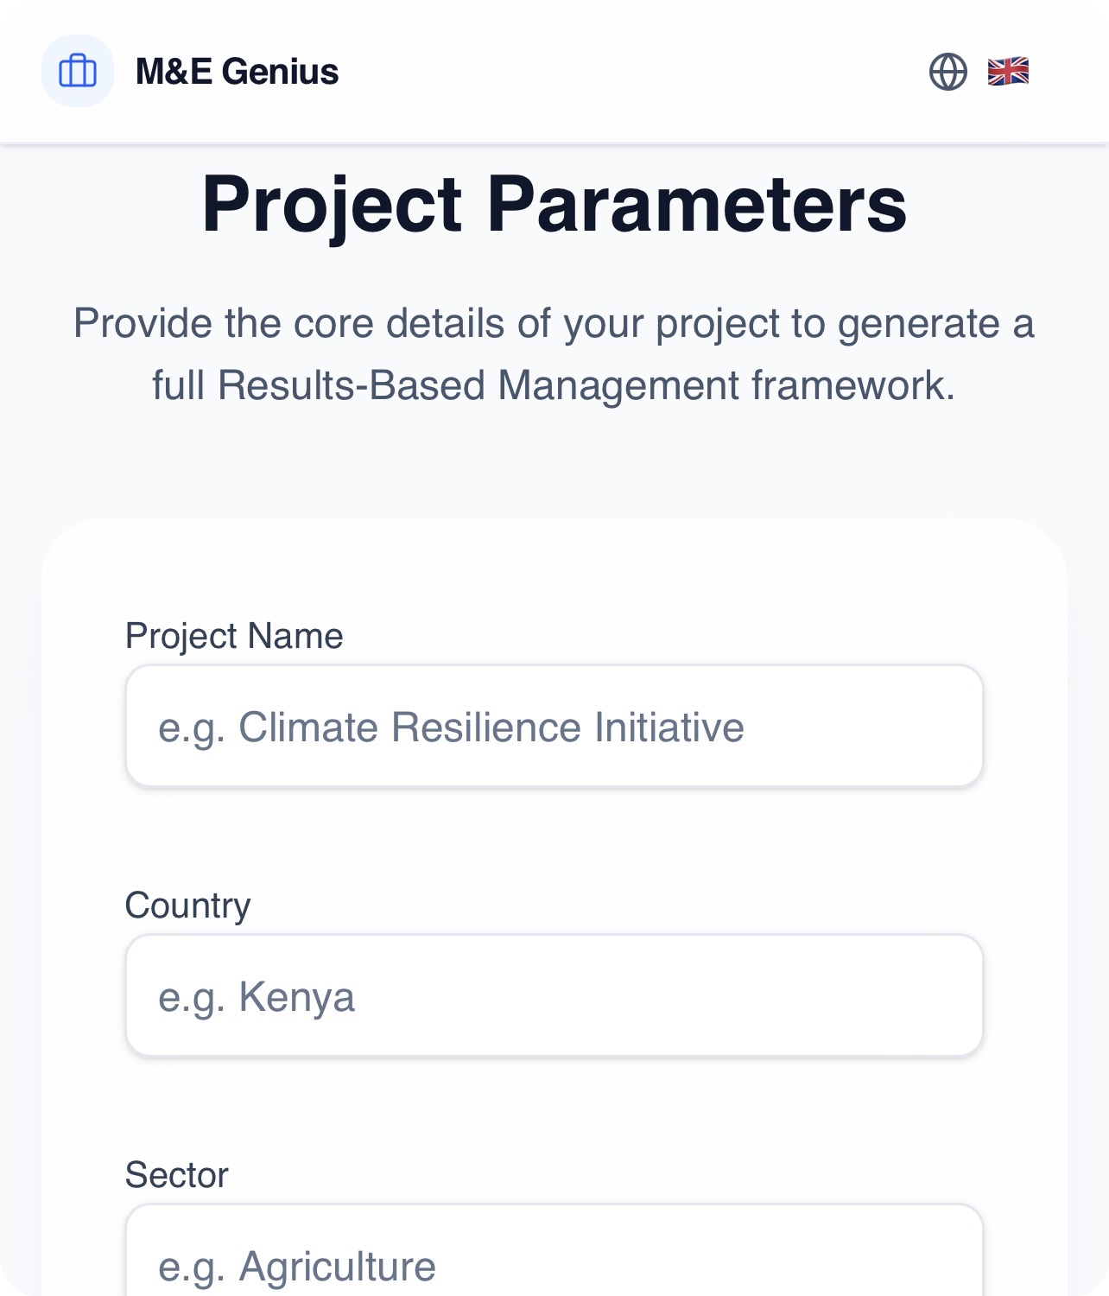
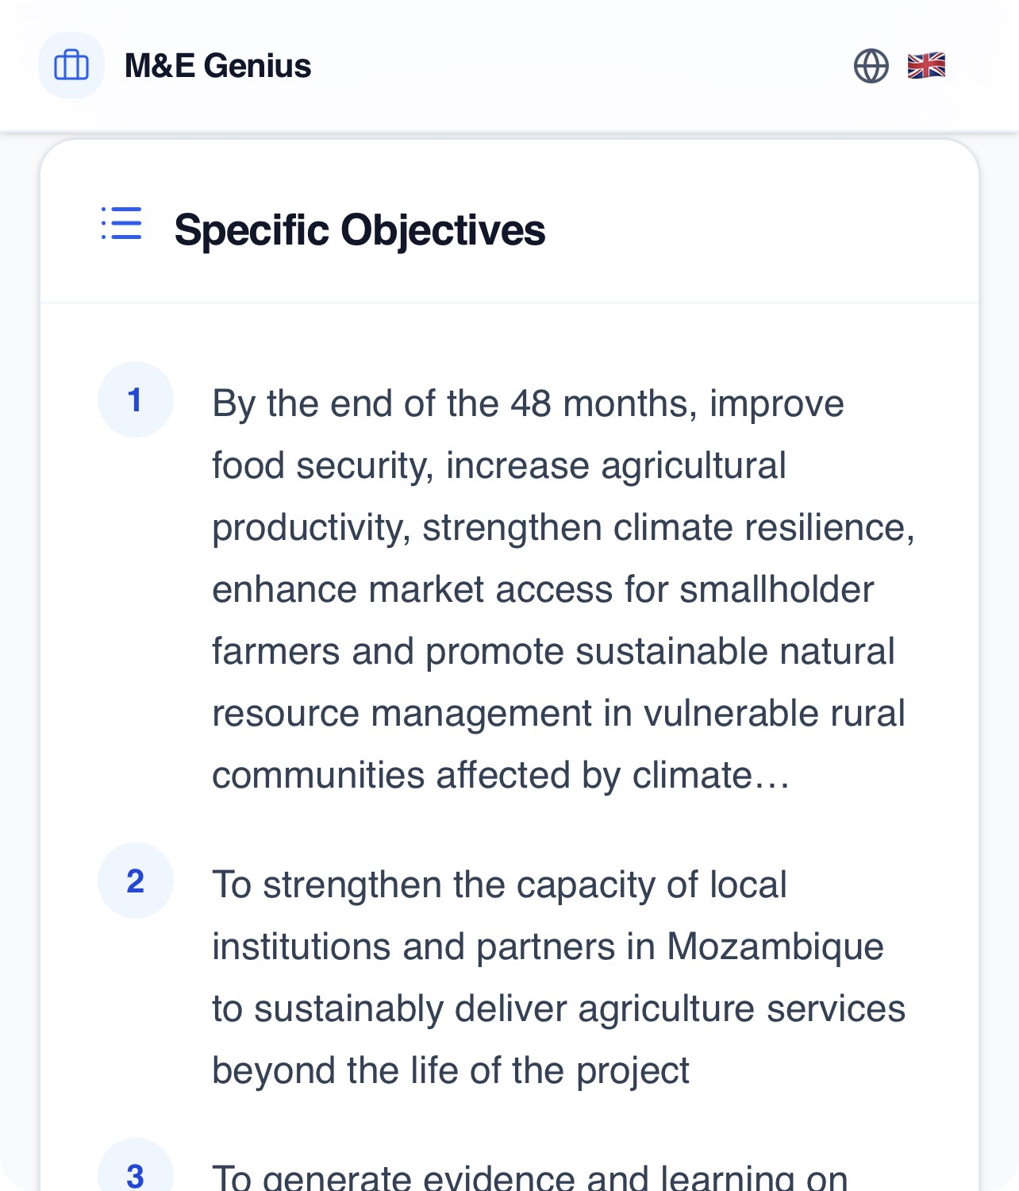
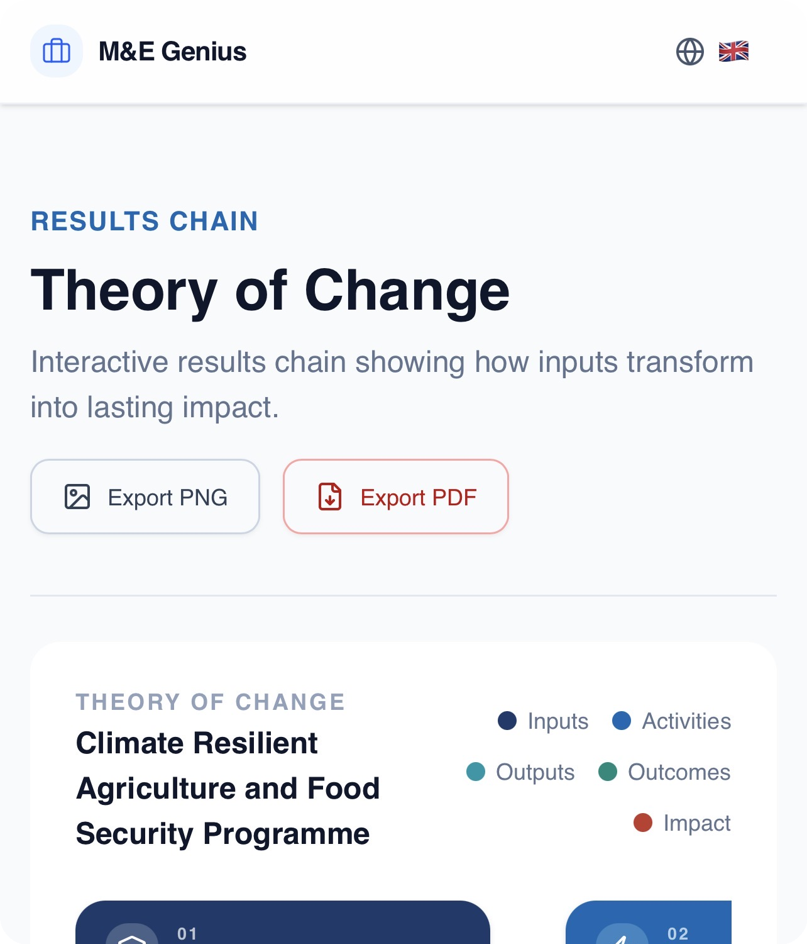
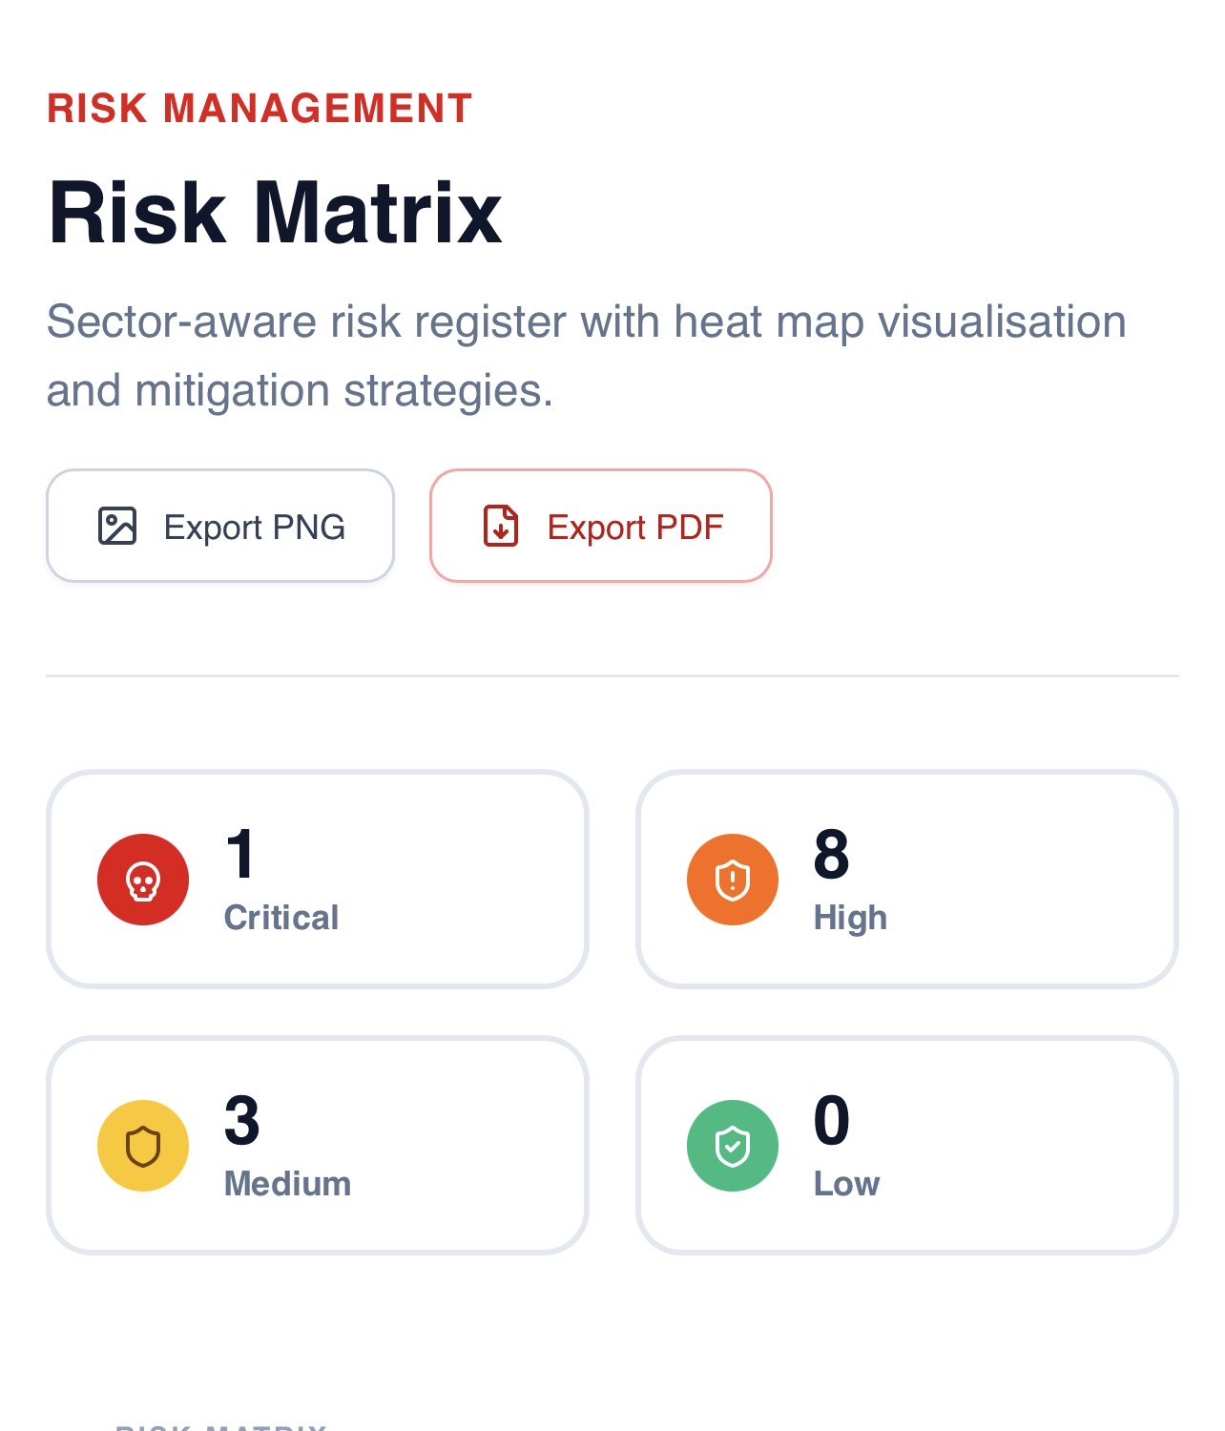
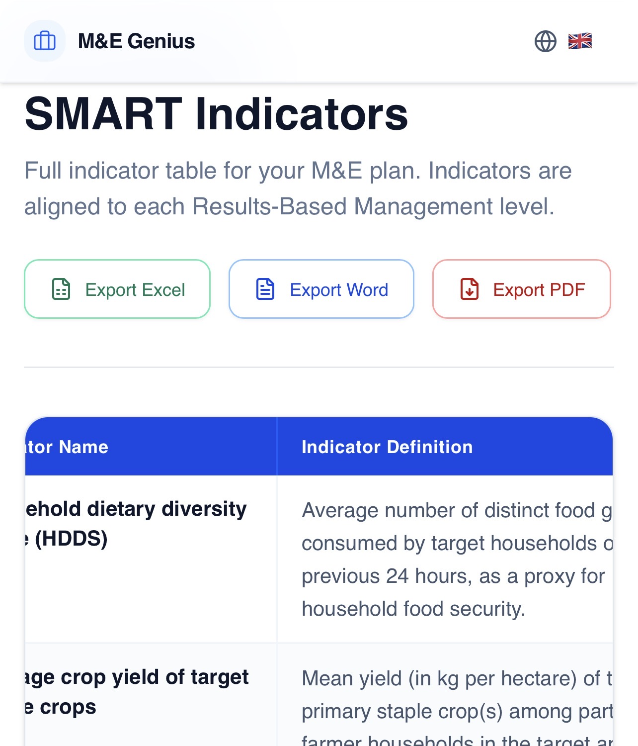
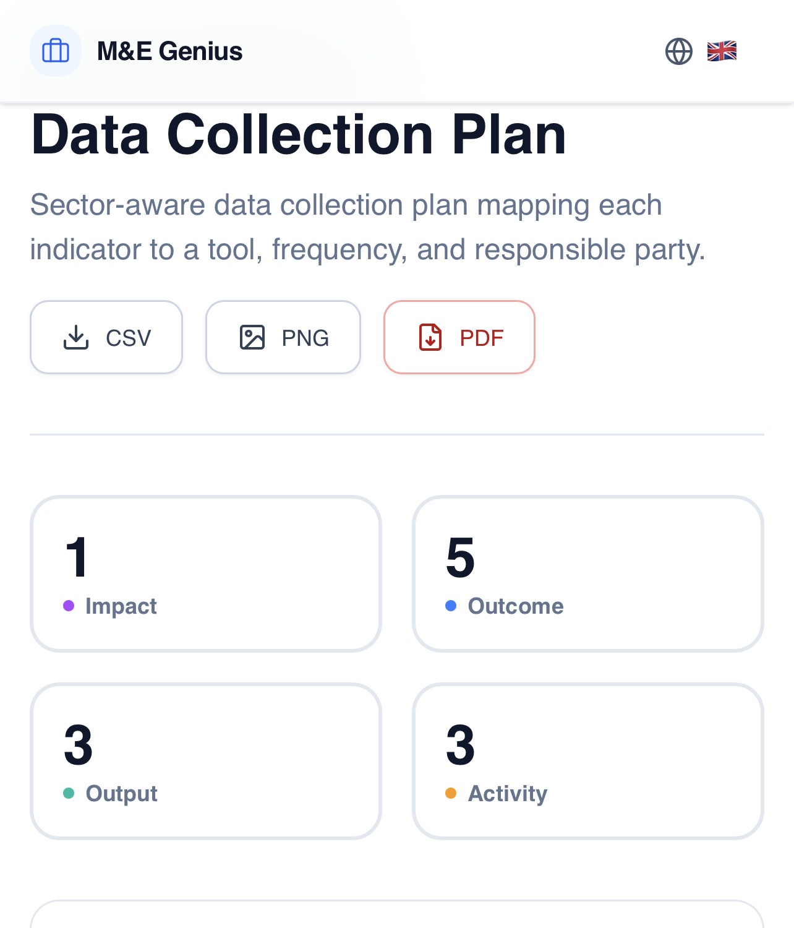
PRODUCT CAPABILITIES
ILLUSTRATIVE DEMO PROJECT
Real Capabilities, Demonstrated
Guided Project Setup
Objectives & Outcomes
Theory of Change
Structured intake of project name, country, sector, donor and duration to frame the M&E design.
Specific objectives and expected outcomes generated in a Results-Based Management structure.
Interactive results chain connecting inputs, activities, outputs, outcomes and impact.
Risk Matrix
SMART Indicators
Data Collection Plan
Sector-aware risk register with probability × impact heat-map and severity counts.
Full indicator table aligned to each Results-Based Management level, exportable to Excel, Word or PDF.
Plan mapping every indicator to a data-collection tool, frequency and responsible party.
M&E GENIUS PRO · KPH Services, Lda.
07

Slide 8
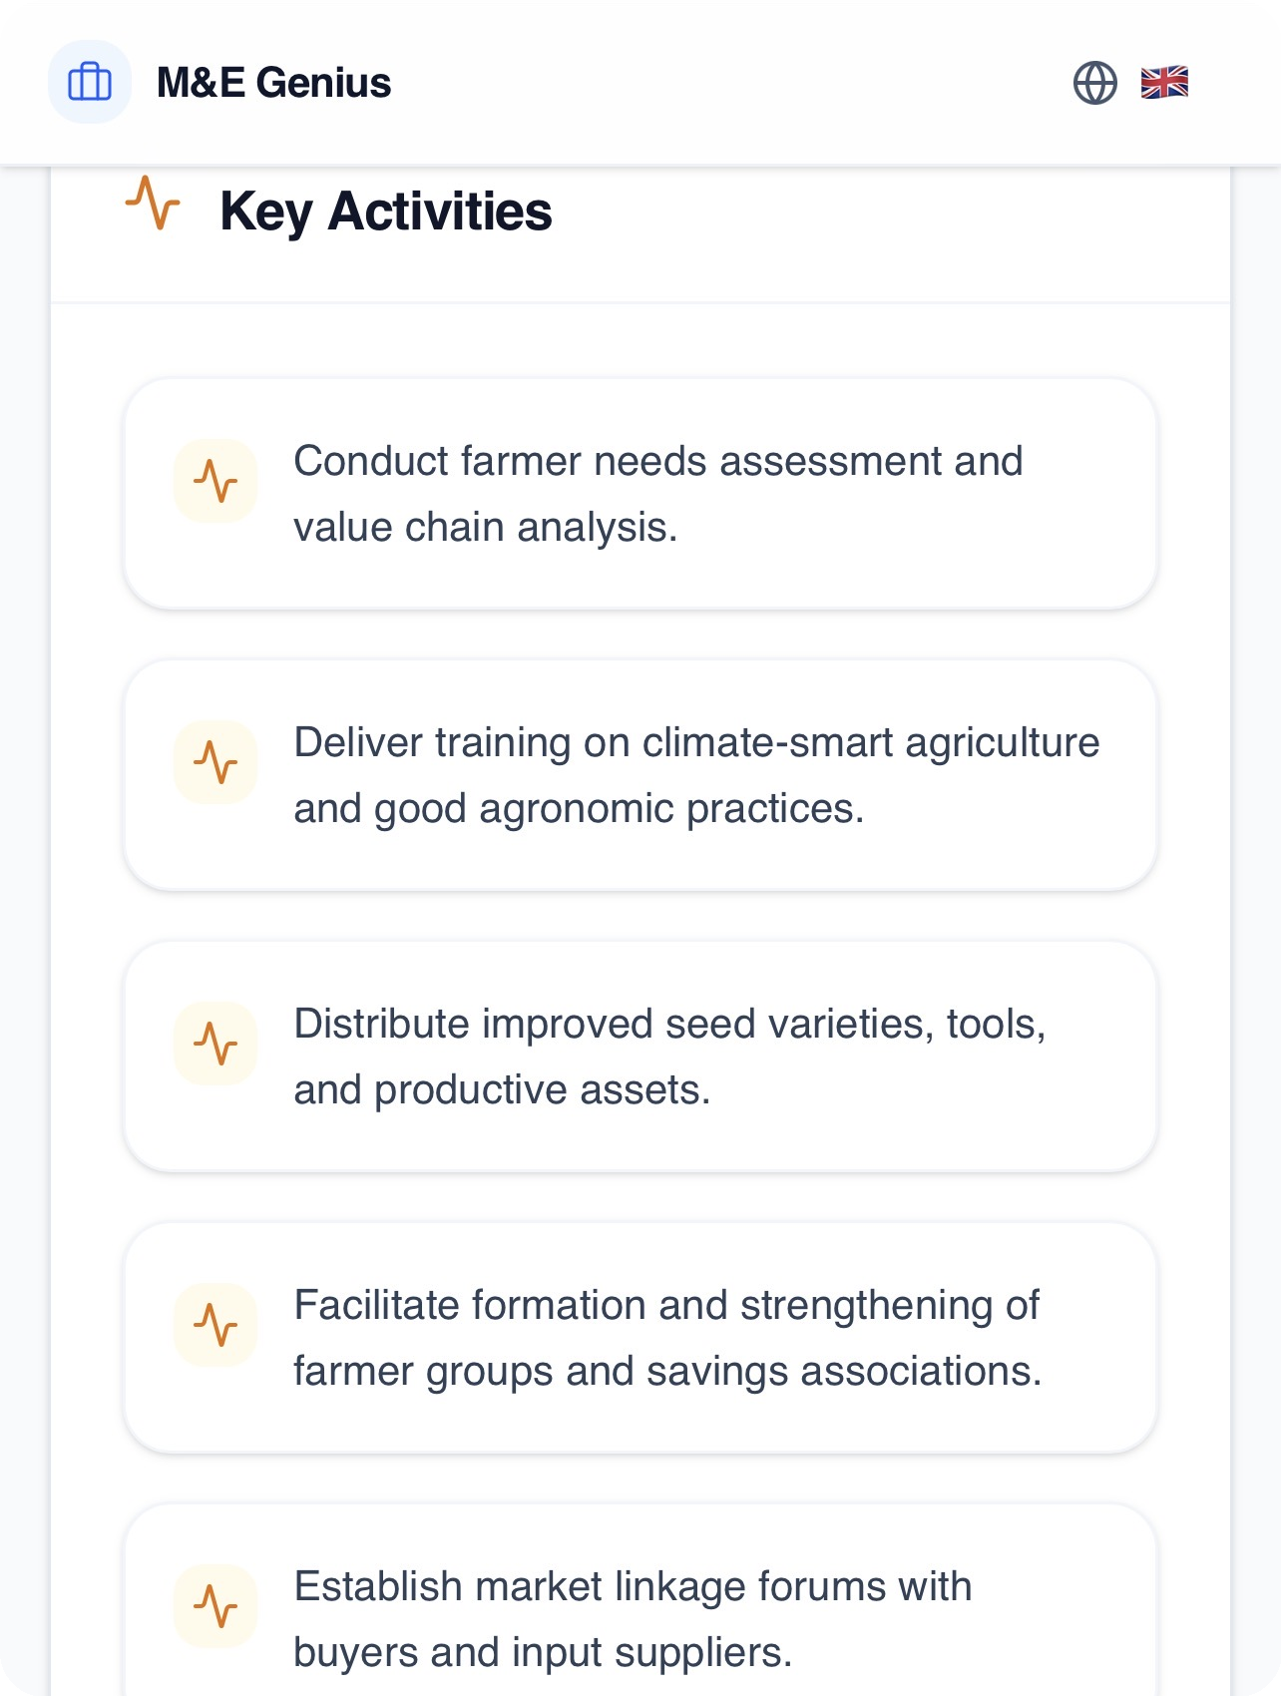
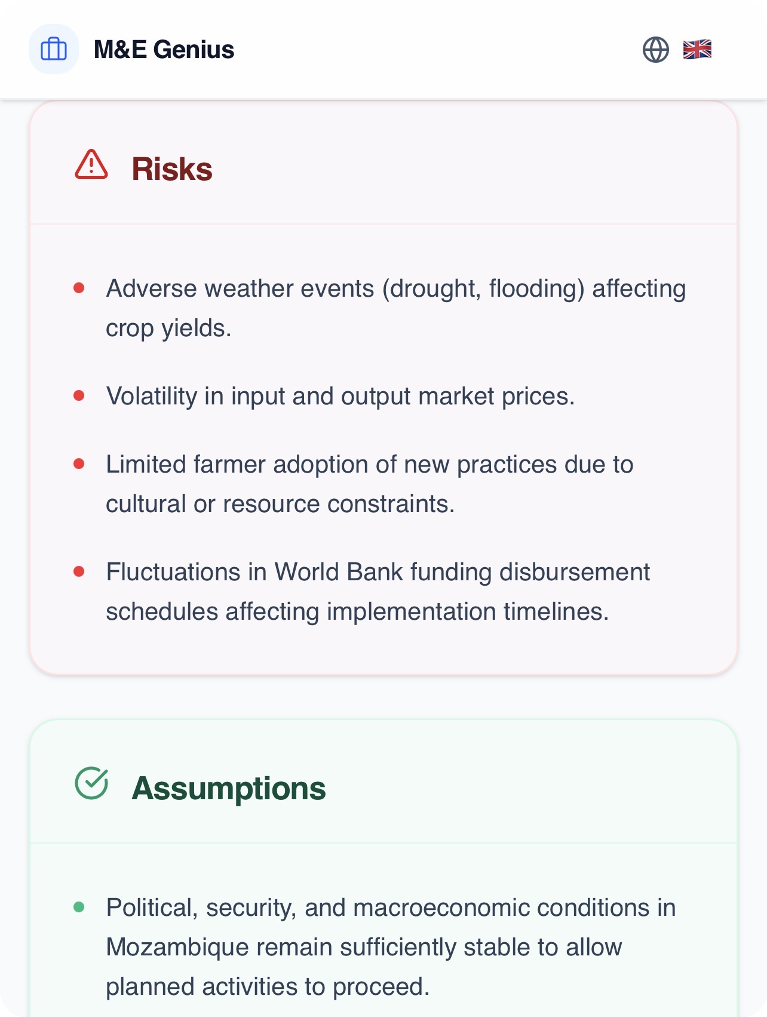

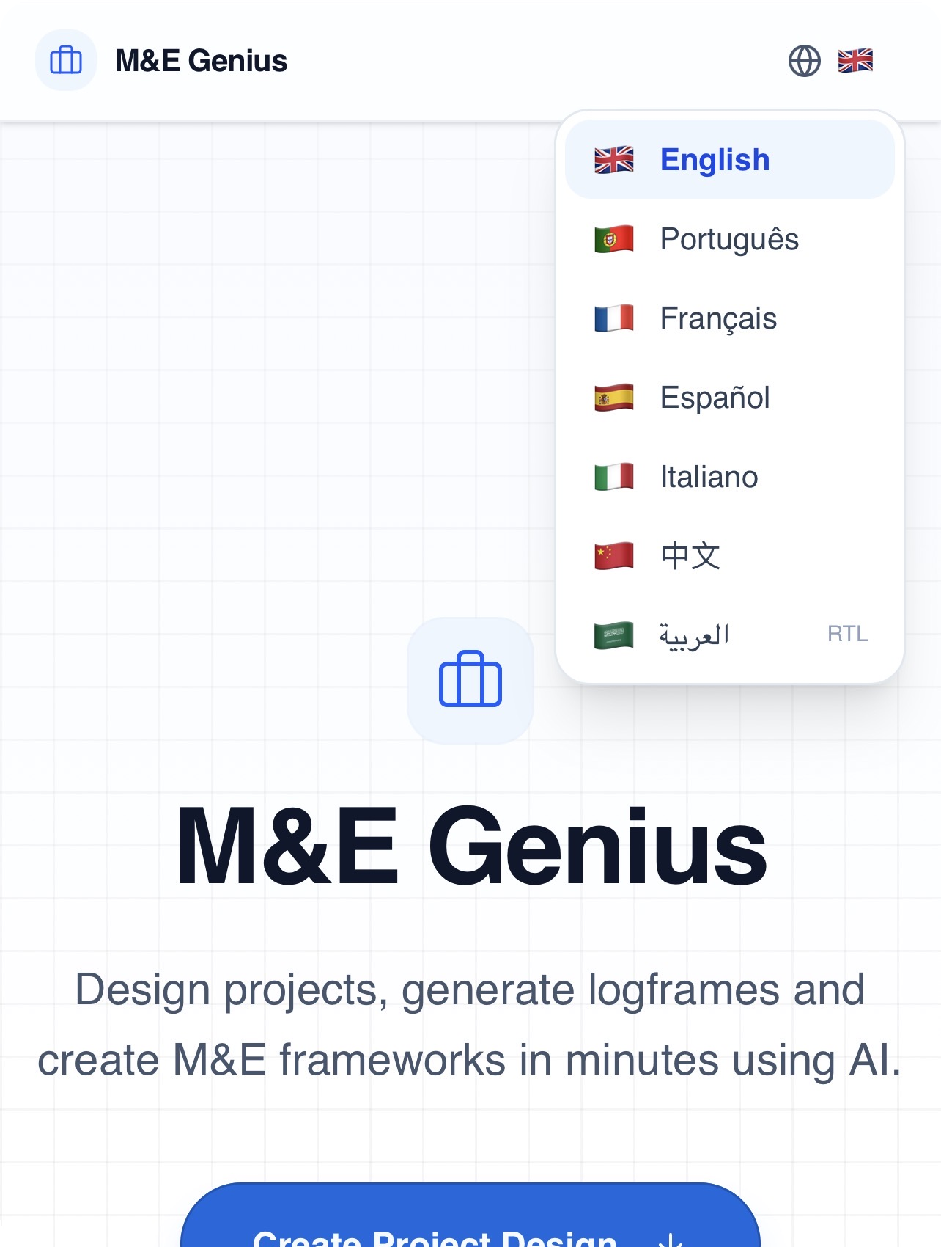
PRODUCT EXPERIENCE
ILLUSTRATIVE DEMO PROJECT
This Is a Real Product, Not Merely an Idea
Key activities linked to each output
Risk & assumption tracking
Full technical proposal document generation
Seven-language interface, including RTL support
08

Slide 9
PRODUCT VALIDATION
PRE-REVENUE · PROOF-OF-CONCEPT STAGE
From Concept to Functional Product
This is no longer just an idea or a pitch-deck concept — a functional proof-of-concept exists and demonstrates the core M&E workflow end to end.
WHAT IS VALIDATED
NOT YET VALIDATED
✓
AI-assisted project design & logframe generation
○
Commercial demand at scale
✓
Results Framework / RBM structuring
○
Recurring revenue & retention
✓
SMART indicator generation
✓
Theory of Change visualisation
○
External customer adoption
✓
Risk matrix / risk register
○
Pricing willingness-to-pay
✓
Data collection plan (prototype)
○
Multi-organisation deployment
✓
Technical proposal & document generation
Honest staging matters more to us than overstated traction.
✓
Word / PDF export
NEXT PHASE
EXTERNAL
PILOTS
→
USER
VALIDATION
→
PRODUCT
REFINEMENT
→
COMMERCIAL
LAUNCH
09

Slide 10

FOUNDER & CEO
Built by an M&E Practitioner
Who Lived the Problem
Founder–Problem Fit
Célio did not start from an abstract AI idea — he experienced the operational problems of M&E, data management, reporting and project delivery first-hand, across more than a decade in the field.
M&E Specialist, Malaria Consortium, Nampula — Nov 2021 to Jan 2025
Led M&E strategy for a Seasonal Malaria Chemoprevention campaign across 23 districts
Célio Matusse
Coordinated and supervised a field network of 245+ agents
Founder & CEO
KPH Services, Lda.
Implemented the SALAMA digital data platform
Reduced data processing and analysis time by ≈30%
10+ years
Designed and led quantitative end-of-cycle / end-of-round surveys; developed strategic reports for international partners
Strategic M&E and data-management experience across Public Health and Energy sectors
Trained 50+ staff in M&E methodology and digital data-collection tools; built dynamic dashboards for real-time visualisation
Experience spans Malaria, HIV/AIDS, TB, Maternal & Child Health, SMC, and prior work connected to the Petroleum & Gas sector
10

Slide 11
VALUE PROPOSITION
Why M&E Genius Pro?
1
2
3
4
EFFICIENCY
VISIBILITY
DATA QUALITY
DECISION SUPPORT
Reduce repetitive manual work in designing and documenting M&E frameworks.
Make project information easier to understand across teams and stakeholders.
Support more structured, consistent use of monitoring information.
Help teams move from raw information toward informed action.
Claims are scoped to the product positioning demonstrated by the application today.
M&E GENIUS PRO · KPH Services, Lda.
11

Slide 12
TARGET USERS
Built for Organisations Managing Projects
NGOs & INGOs
Development Programmes
Government Institutions
✓
✓
✓
Donor-Funded Projects
M&E Teams
Project Management Teams
✓
✓
✓
Consulting Organisations
✓
These are target market segments the product is built for — not confirmed customers. No current customer relationships are claimed here.
M&E GENIUS PRO · KPH Services, Lda.
12

Slide 13
MARKET SIZE
How Large Is the Software Opportunity?
Bottom-up model, sourced anchors and modelled assumptions kept explicitly separate — not a generic “AI is a trillion-dollar market” claim.
MARKET CONTEXT — NOT THE SOFTWARE TAM
Total M&E-related activity within ODA-funded programming globally ≈ US$6.4B–21.2B/yr (OECD DAC ODA 2024 = US$214.6B × 3–10% M&E budget rule-of-thumb). This includes staff time, field data collection and evaluator fees — not software. The addressable software market below is a narrower, separately modelled figure.
ADDRESSABLE SOFTWARE MARKET
TAM
SAM
SOM
Global addressable software market for M&E-specific SaaS
Reachable given language, sector & geographic go-to-market focus
Realistic initial capture for KPH Services, Lda. (3–5 yrs)
≈ US$112M – 375M / yr
≈ US$34M / yr
≈ US$0.6M – 1.5M / yr
•
At least 75,000 internationally active NGOs / INGOs operate globally (research estimate)
•
≈15% of TAM orgs concentrated in Sub-Saharan Africa, Lusophone markets & donor-funded agriculture/health/social projects
•
Initial focus: Mozambique & neighbouring Lusophone / Southern-East African markets
•
Modelled at $1,500–$5,000/org/yr software spend (illustrative range, comparable-SaaS analogy)
•
≈11,250 orgs × ~US$3,000/yr midpoint spend
•
Target: 200–500 organisations in first addressable geographies
•
75,000 × $1.5k–$5k ≈ $112M–375M/yr
•
11,250 × $3k ≈ $34M/yr
•
200–500 × $3k ≈ $0.6M–1.5M/yr
Sourced org count × a modelled (not sourced) spend range — explicitly an estimate, not a market-research figure.
Narrower slice of TAM by realistic go-to-market fit — modelled, not sourced.
Conservative, pre-revenue-stage estimate — modest by design, not a sourced statistic.
Methodology: sourced figures and modelled assumptions are labelled separately throughout. See Sources & References (final slide) for citations.
13

Slide 14
COMPETITIVE LANDSCAPE
A Real Market — Positioned to Differentiate
M&E Genius Pro
M&E-SPECIFIC
AI-native, integrated M&E workflow
Field Data-Collection Tools
KoBoToolbox · CommCare · SurveyCTO · ODK · DHIS2
Results-Management Platforms
TolaData · DevResults · ActivityInfo · LogAlto
GENERIC
Generic AI Assistants
Generic Project-Management SaaS
ChatGPT · Claude · Gemini
Asana · Monday.com · Airtable · Smartsheet
SINGLE-FUNCTION
INTEGRATED WORKFLOW
Not another generic AI chatbot. Not another standalone M&E database.
An AI-native workflow layer connecting Project Design → RBM/Results Framework → Indicators → Risk → Data Collection → Analysis → Reporting → Proposal Generation.
Genuine competition exists in every cluster above and each can perform individual functions well. The claimed differentiation is the integrated, M&E-native AI workflow — not exclusivity, and not proven superiority.
M&E GENIUS PRO · KPH Services, Lda.
14

Slide 15
BUSINESS MODEL
A Scalable Digital Business Model
CURRENT
PROPOSED / PLANNED
Software product delivering AI-assisted M&E project design, indicator frameworks and exportable documentation through a web application.
Organisational subscription — access for a defined number of users and projects
Recurring revenue, billed to the implementing organisation
Tiered access aligned to project volume and feature depth
PRICING UNDER VALIDATION
The commercial model below is a proposed direction for investor discussion, not a finalised offering.
M&E GENIUS PRO · KPH Services, Lda.
15

Slide 16
SCALABILITY
Built to Scale
ONE
PROJECT
→
MULTIPLE
PROJECTS
→
ORGANISATION
→
MULTIPLE
ORGANISATIONS
→
REGIONAL /
INTERNATIONAL
Digital software can potentially serve many organisations without scaling consulting effort linearly — the core advantage of a product-led model over service delivery.
No claim of actual international deployment is made — this reflects the intended growth path, not current reach.
M&E GENIUS PRO · KPH Services, Lda.
16

Slide 17
ROADMAP
From Proof of Concept to Commercial Launch
Proof of Concept → Product Hardening → Pilots → External Validation → Commercial Launch → Scale
CURRENT / DEMONSTRATED
ROADMAP / FUTURE
•
AI-assisted project design & logframe generation
•
Organisational multi-user accounts & permissions
•
Theory of Change results-chain visualisation
•
Live field data collection & indicator tracking
•
SMART indicator tables with Excel / Word / PDF export
•
Dashboards for real-time portfolio visibility
•
Risk matrix with heat-map visualisation
•
Third-party integrations (donor & grants systems)
•
Data collection planning
•
Multi-language interface (7 languages, incl. RTL)
•
Finalised commercial pricing & billing
•
Full technical proposal document generation
M&E GENIUS PRO · KPH Services, Lda.
17

Slide 18
VISION
The Future of Project M&E
Should Be Intelligent.
M&E Genius Pro aims to become a trusted digital intelligence layer for organisations that plan, monitor, evaluate and manage development projects — turning fragmented monitoring data into structured, actionable decision support at scale.
18

Slide 19
INVESTMENT ASK
INVESTMENT STRUCTURE OPEN TO DISCUSSION
US$220,000 Target Investment
Range: US$100,000 minimum · US$220,000 target · US$250,000 maximum
WHAT WILL THE CAPITAL FUND
TOTAL ≈ US$220,000
WHAT IT UNLOCKS
AI / M&E Intelligence
$40k
Product hardening
SaaS Engineering
$30k
MVP / Product Development
$20k
7-language production
7-Language Production
$15k
External pilots
Pilots (external validation)
$12k
UX / UI
$10k
User validation
Sales & Market Expansion
$35k
Marketing
$25k
Commercial readiness
Legal / Operations
$20k
First revenue
Contingency
$13k
Indicative allocation for investor discussion — categories reflect the company's current planning; the total is scaled to the US$220,000 target.
Transforming project data into better decisions.
19

Slide 20
SOURCES & REFERENCES
Methodology & Citations
ODA total (2024, final)
OECD, "Final OECD statistics on official development assistance (ODA) and other resource flows to developing countries in 2024," Dec 2025 — DAC ODA = US$214.6B. Used only for market-context sizing, not the software TAM.
M&E budget rule-of-thumb
UNDP, USAID Evaluation Toolkit, W.K. Kellogg Foundation Step-by-Step Guide to Evaluation (2017) — M&E commonly budgeted at 3–10% of program cost.
International NGO count
Estimate of "at least 75,000 international NGOs" — Introduction to the Nonprofit Sector (Univ. of Oregon open textbook), cross-referenced against country-level NGO registries. Basis for the software TAM/SAM organisation count.
Competitor landscape
EvalCommunity, Monitoring and Evaluation NEWS (mande.co.uk), and product-comparison research (2025–2026) on TolaData, DevResults, ActivityInfo, DHIS2, KoBoToolbox, CommCare, SurveyCTO, ODK, Asana, Monday.com, Airtable, Smartsheet, ChatGPT, Claude and Gemini.
SaaS pricing assumption
Illustrative annual spend per organisation ($1,500–$5,000 range; $3,000 midpoint), modelled by analogy to comparable nonprofit-sector SaaS subscription pricing — not a sourced statistic.
M&E GENIUS PRO · KPH Services, Lda.
20
Sourced figures and modelled assumptions are distinguished throughout this presentation. Full source links available on request.

